Slide 1


Cognitive Services Overview

Slide 2
Cortana Intelligence Suite
Cognitive Services
Notes:
Hi, I’m ___, and I’m excited to discuss Microsoft’s Cortana Intelligence Suite, and the value it can deliver to your organization.
More specifically, we’re going to talk about Microsoft Cognitive Services.

Slide 3



Easily turn data into intelligent action
Information Management
Big Data Stores
Machine Learning and Analytics
Intelligence
Data Sources
People
Data Factory
Data Lake Store
Machine Learning
Cognitive Services
Data Catalog
SQL Data
Warehouse
Data Lake Analytics
Bot Framework
Web
Apps
HDInsight
(Hadoop and Spark)
Event Hubs
Cortana
Mobile
Apps
Stream Analytics
Bots
Dashboards & Visualizations
Sensors and devices
Power BI
Automated Systems
Data
Intelligence
Action
Notes:
Cortana Intelligence delivers an end-to-end platform with an integrated and comprehensive set of tools and services to help you build intelligent applications that let you easily take advantage of Advanced Analytics and intelligence capabilities.
First, Cortana Intelligence provides services to bring data in, so that you can analyze it. It provides information management capabilities like Azure Data Factory so that you can pull data from any source (relational DB like SQL or non-relational ones like your Hadoop cluster) in an automated and scheduled way, while performing the necessary data transforms (like setting certain data columns as dates vs. currency etc). Think ETL (Extract, Transform, Load) in the cloud. Event Hubs does the same for IoT type ingestion of data that streams in from lots of end points.
The data brought in then can be persisted in flexible big data storage services like Data Lake Store and Azure SQL Data Warehouse.
You can then use a wide range of analytics services from Machine Learning to Azure Data Lake Analytics to Azure HDInsight to Azure Stream Analytics to analyze the data stored in the big data storage. This means you can create analytics services and models specific to your business need (say real time demand forecasting).
The resultant analytics services and models created by taking these steps can then be surfaced as interactive dashboards and visualizations via Power BI.
These same analytics services and models created can also be integrated into various different UI (web apps or mobile apps or rich client apps), or with Cortana, so end users can naturally interact with them via speech etc., and so that end users can get proactively be notified by Cortana if the analytics model finds a new anomaly (unusual growth in certain product purchases- in the case of real time demand forecasting example given above) or whatever deserves the attention of the business users. Similar integration can occur with Cognitive Services or Bot Framework based applications.
At a high level though, Cortana Intelligence capabilities are in three main areas: data, analytics and intelligence.
<Transition>: We’re going to dive into each one.

Slide 4
Easily turn data into intelligent action
Information Management
Big Data Stores
Machine Learning and Analytics
Intelligence
Data Sources
People
Data Factory
Data Lake Store
Machine Learning
Cognitive Services
Data Catalog
SQL Data
Warehouse
Data Lake Analytics
Bot Framework
Web
Apps
HDInsight
(Hadoop and Spark)
Event Hubs
Cortana
Mobile
Apps
Stream Analytics
Bots
Dashboards & Visualizations
Sensors and devices
Power BI
Automated Systems
Data
Intelligence
Action
Notes:
We’re going to detail the Intelligence layer, more specifically the Cognitive Services.

Slide 5









Why Microsoft Cognitive Services?
Easy
Flexible
Tested
Roll your own with REST APIs
Simple to add: just a few lines of code required
Integrate into the language and platform of your choice
Breadth of offerings helps you find the right API for your app
Built by experts in their field from Microsoft Research, Bing, and Azure Machine Learning
Quality documentation, sample code, and community support
GET A KEY
BUILD
Notes:
Why choose these APIs? They work, and it’s easy.
Easy: The APIs are easy to implement because of the simple REST calls. Being REST APIs, there’s a common way to implement and you can get started with all of them for free simply by going to one place, one website, www.microsoft.com/cognitive. (You don’t have to hunt around to different places.)
Flexible: We’ve got a breadth of intelligence and knowledge APIs so developers will be able to find what intelligence feature they need; and importantly, they all work on whatever language, framework, or platform developers choose. So, devs can integrated into their apps—iOS, Android, Windows—using their own tools they know and love (such as python or node.js, etc.).
Tested: Tap into an ever-growing collection of powerful AI algorithms developed by experts. Developers can trust the quality and expertise build into each API by experts in their field from Microsoft’s Research organization, Bing, and Azure machine learning and these capabilities are used across many Microsoft first party products such as Cortana, Bing and Skype.

Slide 6
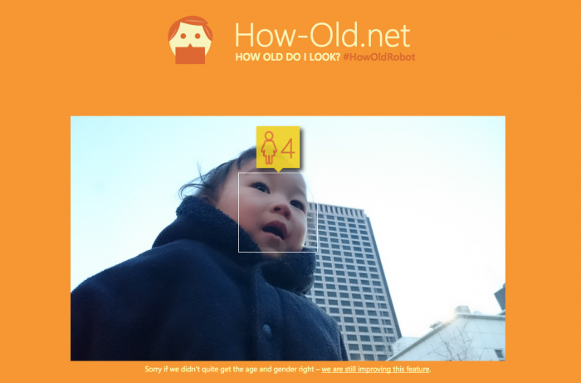
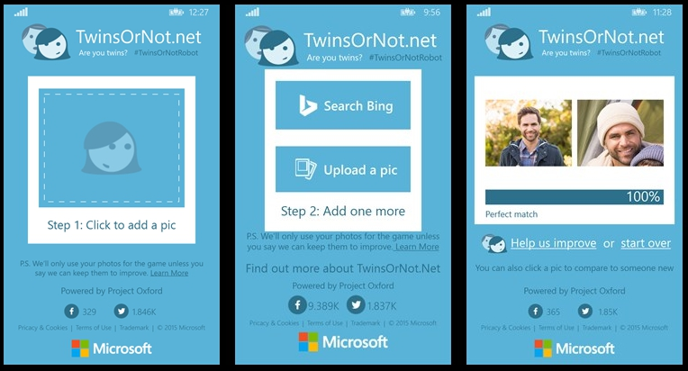

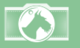
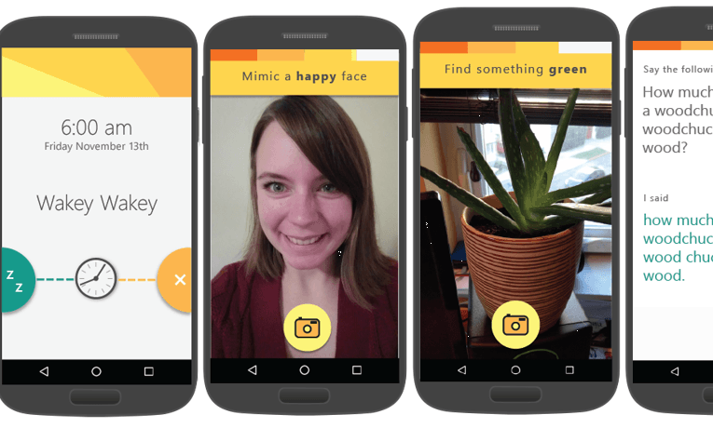

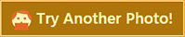



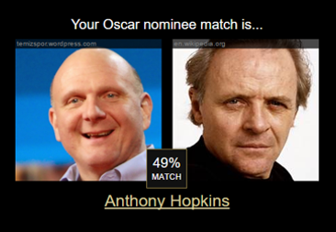


Our Showcase Apps (visit our app catalog at aka.ms/cognitivegallery)
Fetch
CaptionBot.ai
CelebsLike.Me
ProjectMurphy.net
I think it’s a person sitting in front of a computer and he seems ☺. I am 99% sure that’s Bill Gates
“what if Satya Nadella had a long beard?”

Slide 7
The APIs
Notes:
Anna, 2m
-----------------------------------
Understand and intelligently act on data
“democratization”
Easy, Xplat, High-Tech

Slide 8

Microsoft Cognitive Services Domains
Vision
From faces to feelings, allow your apps to understand images and video
Cognitive Services
Give your solutions a human side
Speech
Hear and speak to your users by filtering noise, identifying speakers, and understanding intent
Language
Process text and learn how to recognize what users want
Knowledge
Tap into rich knowledge amassed from the web, academia, or your own data
Search
Access billions of web pages, images, videos, and news with the power of Bing APIs
Notes:
What are Cognitive Services? Microsoft Cognitive Services are a new collection of intelligence and knowledge APIs that enable developers to ultimately build smarter apps.

Slide 9
Microsoft Cognitive Services Collections
Vision
Computer Vision | Emotion | Face | Video
Cognitive Services
Give your solutions a human side
Speech
Custom Recognition | Speaker Recognition Speech
Language
Bing Spell Check | Language Understanding Linguistic Analysis | Text Analytics | Web Language Model
Knowledge
Academic Knowledge | Entity Linking Knowledge Exploration | Recommendations
Search
Bing Auto Suggest | Bing Image Search | Bing News Search Bing Video Search | Bing Web Search
Notes:
At Microsoft, we’ve been offering APIs for a very long time across the company. In delivering Microsoft Cognitive Services API, we started with 4 last year at /build (2015); added 7 more last December, and today we have 22 APIs in our collection.
Cognitive Services are available individually or as a part of the Cortana Intelligence Suite, formerly known as Cortana Analytics, which provides a comprehensive collection of services powered by cutting-edge research into machine learning, perception, analytics and social bots.
These APIs are powered by Microsoft Azure.
Developers and businesses can use this suite of services and tools to create apps that learn about our world and interact with people and customers in personalized, intelligent ways.

Slide 10
Vision
From faces to feelings, allow your apps to understand images and video
Computer Vision | Emotion | Face | Video

Slide 11

Computer Vision APIs
Analyze an image Understand content within an image
OCR Detect and recognize words within an image
Generate thumbnail Scale and crop images, while retaining key content
Notes:
Do you need an API that gives you actionable information about images used in your app? The Computer Vision API gives you the tools to understand the contents of any image. Create tags identifying objects, beings, or actions present in the image, and then craft coherent sentences to describe it. Whether you want to execute better image search, or you want to create an assistive app for the visually impaired, the Computer Vision API helps get the job done.

Slide 12
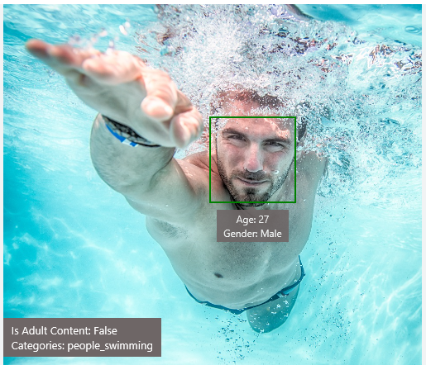
Analyze image
Type of image
Clip Art Type 0 Non-clipart
Line Drawing Type 0 Non-Line Drawing
Black & White Image False
Content of image
Categories [{ “name”: “people_swimming”, “score”: 0.099609375 }]
Adult Content False
Adult Score 0.18533889949321747
Faces [{ “age”: 27, “gender”: “Male”, “faceRectangle”: {“left”: 472, “top”: 258, “width”: 199, “height”: 199}}]
Image colors
Dominant Color Background White
Dominant Color Foreground Grey
Dominant Colors White
Accent Color

Slide 13

OCR
Good at
Scanned documents
Photos with text
Fine grained location information
Vehicle license plate
Hand-written text
Characters with large sizes

Slide 14




Smart thumbnail
Smart cropping
Smart cropping

Slide 15

Recognize emotions Detect emotions based on facial expressions in photos and videos
Emotion APIs
Notes:
How are you feeling? Can your app tell? With the Emotion API, you can build an app that recognizes emotions according to facial expressions—giving you the capability to provide an amazing, personalized experience.
Using facial expressions, this cloud-based API can detect happiness, neutrality, sadness, contempt, anger, disgust, fear, and surprise. The AI understands these emotions based on universal facial expressions, and it functions cross-culturally, so your app will work around the world.

Slide 16
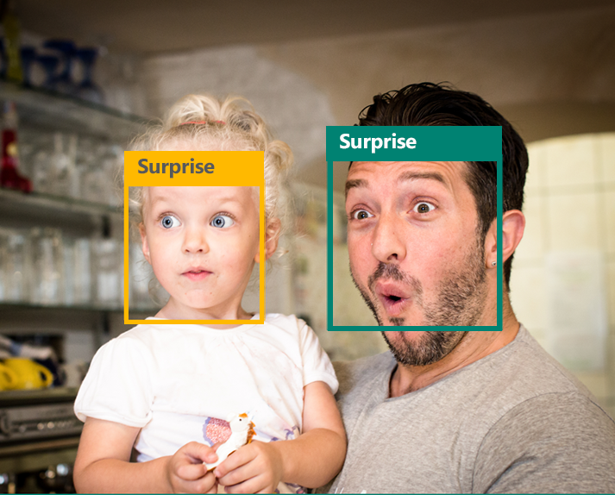
Emotion APIs
Face detection
"faceRectangle": {"width": 193, "height": 193, "left": 326, "top": 204} …
Emotion scores
“scores": { "anger": 5.182241e-8,
"contempt": 0.0000242813,
"disgust": 5.621025e-7,
"fear": 0.00115027453,
"happiness": 1.06114619e-8,
"neutral": 0.003540177,
"sadness": 9.30888746e-7,
"surprise": 0.9952837}

Slide 17

Face APIs
Face detection Detect faces and their attributes within an image
Face verification Check if two faces belong to the same person
Similar face searching Find similar faces within a set of images
Face grouping Organize many faces into groups
Face identification Search which person a face belongs to
Notes:
Detect human faces and compare similar ones, organize people into groups according to visual similarity, and identify previously tagged people in images.

Slide 18




Face APIs
Detection
"faceRectangle": {"width": 193, "height": 193, "left": 326, "top": 204}
…
Feature attributes
"attributes": { "age": 42, "gender": "male",
"headPose": { "roll": "8.2", "yaw": "-37.8", "pitch": "0.0" }}
Grouping
Identification
Jasper Williams

Slide 19


Video APIs
Stabilization Smooth and stabilize shaky video
Face detection and tracking Detect and track faces in videos
Motion detection Detect when motion occurs
Notes:
Intelligent video processing produces stable video output, detects motion, creates intelligent thumbnails, and detects and tracks faces.

Slide 20
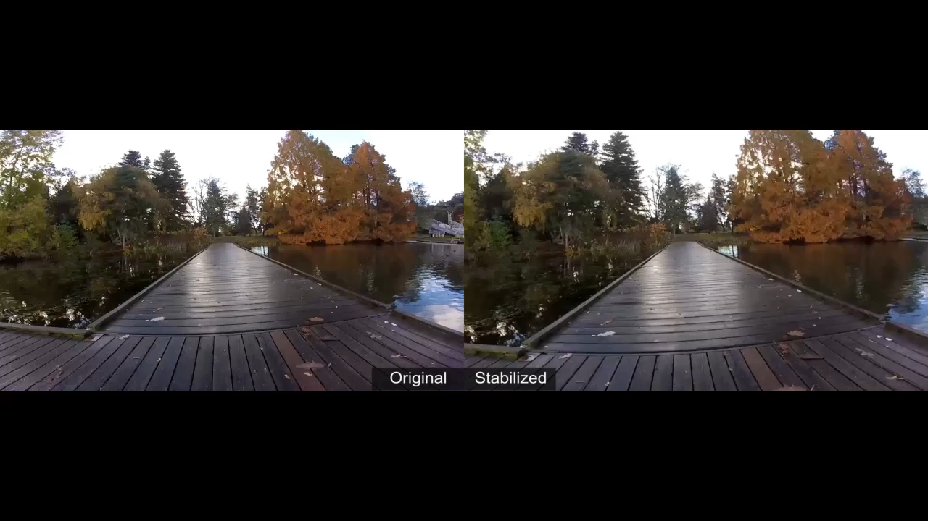
Stabilization
The Stabilization API provides automatic video stabilization and smoothing for shaky videos
This API uses many of the same technologies found in Microsoft Hyperlapse
Best For: Small camera motions, with or without rolling shutter effects (e.g., holding a static camera, walking with a slow speed)

Slide 21

Face detection and tracking
High precision face location detection and tracking
Can detect up to 64 human faces in a video (no smaller than 24x24 pixels)
Detected and tracked faces are returned with coordinates and a Face ID to track throughout the video
Time (sec) | Face ID | x, y | Width, height
0 | 0 | 0.59, 0.23 | 0.09, 0.16
0 | 1 | 0.38, 0.15 | 0.07, 0.12
1 | 0 | 0.54, 0.25 | 0.09, 0.15
1 | 1 | 0.23, 0.18 | 0.07, 0.12

Slide 22
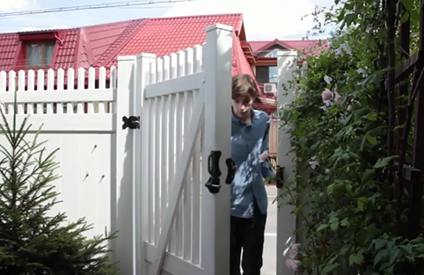
Motion detection
Indicates when motion occurs against a fixed background (e.g., surveillance video)
Trained to reduce false alarms, such as lighting and shadow changes
Current limitations:
No support for night-vision videos
Semi-transparent and small objects are not detected well
Start time | End time | In region
1.9 | 3.6 | 0
5.2 | 15.1 | 0

Slide 23
Speech
Hear and speak to your users by filtering noise, identifying speakers, and understanding intent
Custom Recognition | Speaker Recognition | Speech

Slide 24

Speech APIs
Voice recognition (speech to text) Converts spoken audio to text
Voice output (text to speech) Synthesize audio from text
Speech intent recognition Convert spoken audio to intent
Notes:
Convert audio to text, understand intent, and convert text back to speech for natural responsiveness.
Speech Intent Recognition can return recognized text from audio inputs. It also returns structured information about speech to the apps that parse the intent of the speaker and drive further actions by the app. Models trained by Project Oxford LUIS service are used to generate the intent.

Slide 25

Speech API
Recognize Voice – Converts spoken audio to text. Support for 18 languages (28 locales)
Synthesize Speech – Synthesize audio from Text. Support for 9 languages (17 locales)
Speech
Recognition
Speech Intent Recognition
Text to Speech Conversion
450 6th St. San Francisco
"450 sixth St in San Francisco."
"For 50 six St San Francisco."
"456th St San Francisco."
Convert spoken audio to text
Convert audio to intent
Convert text to spoken audio

Slide 26
Speaker recognition API
“”
Speaker verification Check if two voices are the same
Speaker identification Identify who is speaking
Notes:
Your users' voices are their passports with the Speaker Recognition API. Your app can authenticate identities by using someone's voice, giving your users the capability to interact securely through speech.

Slide 27

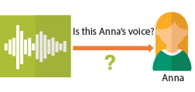
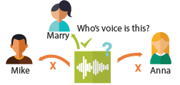
Speaker Recognition APIs
Speaker Verification – Check if two voices are the same
Speaker Identification – Identify who is speaking and create a unique voiceprint for a profile
Speaker Verification
Speaker Identification
Who’s voice is this?
Is this Ann’s voice?
Mary
Ann
Mike
Ann
After enrolling one or more voices, identify who is speaking from an audio clip
Confirm if a voice belongs to a previously enrolled profile.

Slide 28

Custom Recognition
Customize both language and acoustic models Tailor speech recognition to your app and environment
Notes:
It Eliminate speech recognition barriers like speaking style, background noise, and vocabulary.
The Custom Recognition Intelligent Service (CRIS) helps you create custom speech recognition endpoints. So accents and environments are features, not challenges anymore.

Slide 29
Language
Process text and learn how to recognize what users want
Bing Spell Check | Language Understanding | Linguistic Analysis | Text Analytics | Web Language Model

Slide 30

Bing spell check APIs
State-of-the-art cloud based spelling algorithms Recognizes a wide variety of spelling errors
Recognize name errors and homonyms in context Difficult to spot errors that use the context of the words around them
Updates over time Support for new brands and coined expressions as they emerge
Notes:
The Bing Spell Check API corrects spelling errors, contextually recognizes names and slang, understands homonyms, and supports brand names.

Slide 31



Bing spell check APIs
Check a single word or a whole sentence
“Our engineers developed this four you!”
Corrected Text: “four” → “for”
Identify errors and get suggestions
"spellingErrors": [
{
"offset": 5,
"token": "gona",
"type": "UnknownToken",
"suggestions": [
{ "token": "gonna" }
] }

Slide 32

Language Understanding
Understand what your users are saying Use pre-built Bing and Cortana models or create your own
Notes:
This Understands language contextually, so your app communicates with people in the way they speak.
With the Language Understanding Intelligent Service (LUIS) API, you can integrate language models that understand your users quickly and easily. And if one of our preexisting models won't work, it will guide you through building your own.
Prebuilt models will recognize places, times, numbers, and temperatures, and handle common requests like "set an alarm for 8 AM." LUIS supports dialogue and action fulfillment, so your users can carry on a conversation with your app. For example, the input "schedule a meeting with Allison" results in the question "when?," allowing the user to respond "3 PM," and the meeting gets scheduled.

Slide 33

Language Understanding Intelligent Service (LUIS)
Read me the headlines
Intent: TextToSpeech
Content: NewsHeadlines
Determine Intent – Understand what your users are saying in natural language
Determine Entities – Identify entities within the sentence
Active Learning – Train your model and improve it as you collect more data.
Pre-built Models – Leverage world class models from Bing and Cortana
Play yesterday’s Daily Show
Intent: PlayEpisode
Content: Daily Show
DateTime.date: T-1 Day
Pause for 5 minutes
Intent: PauseDevice
DateTime.duration: 5 Minutes

Slide 34
Language understanding models
{
“entities”: [
{
“entity”: “flight_delays”,
“type”: “Topic”
}
],
“intents”: [
{
“intent”: “FindNews”,
“score”: 0.99853384
},
{
“intent”: “None”,
“score”: 0.07289317
},
{
“intent”: “ReadNews”,
“score”: 0.0167122427
},
{
“intent”: “ShareNews”,
“score”: 1.0919299E-06
}
]
}
“News about flight delays”

Slide 35
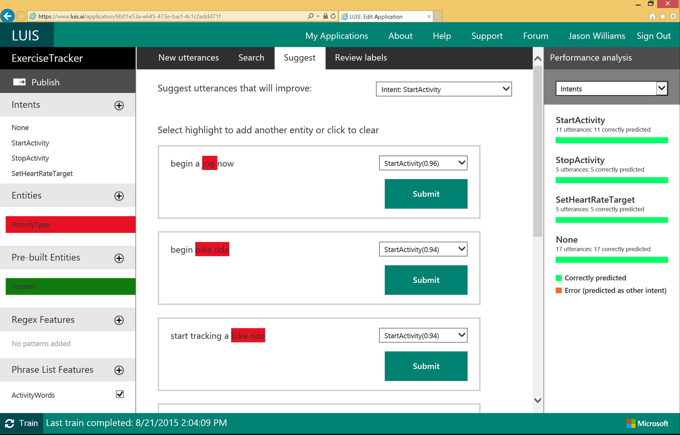

Slide 36

Linguistic analysis
Analysis tools for natural language processing Access to part-of-speech tagging and parsing, identifying concepts, and actions
Notes:
You know what your users are saying, but do you know what it means? The Linguistic API uses advanced linguistic analysis tools for natural language processing, giving you access to part-of-speech tagging and parsing. These tools allow you to hone in on important concepts and actions. The API can tap into traditional linguistic analysis tools that allow you to identify the concepts and actions in your text with part-of-speech tagging, and find phrases and concepts using natural language parsers. Whether you’re mining customer feedback, interpreting user commands, or consuming web text, understanding the structure of the text is a critical first step.

Slide 37

Text analytics
Sentiment analysis Understand if a record has positive or negative sentiment
Key phrase extraction Extract key phrases from a piece of text, and retrieve topics
Topic detection Use clustering techniques to identify the trending topics on a large set of text records
Language detection Identify the language, 120 supported languages
Notes:
Understanding and analyzing unstructured text is an increasingly popular field and includes a wide spectrum of problems such as sentiment analysis, key phrase extraction, topic modeling/extraction, aspect extraction and more.
Text Analytics API is a suite of text analytics services : we currently offer APIs for sentiment analysis, key phrase extraction and topic detection for English text, as well as language detection for 120 languages. In this initial preview release, we offer APIs for sentiment analysis and key phrase extraction of English text. No labeled or training data is needed to use the service - just bring your text data. This service is based on research and engineering that originated in Microsoft Research and which has been battle-tested and improved over the past few years.

Slide 38

Web language model
Automation of a variety of standard natural language processing tasks using state-of-the-art language modeling APIs Word breaking, joint probability of natural language expressions, scoring, and predicting following words in a sequence
Notes:
Automate a variety of standard natural language processing tasks using state-of-the-art language modeling APIs.
Do you need to know how frequently certain words appear together? Or figure out which words a user might type next? Or how to break a hashtag into individual words? The Web Language Model API lets your app do all of this quickly and accuratel.

Slide 39
Knowledge
Tap into rich knowledge amassed from the web, academia, or your own data
Academic Knowledge
Entity Linking | Knowledge Exploration
Recommendations

Slide 40

Knowledge
Academic Knowledge API
Knowledge Exploration Service
Entity Linking Service
Recommendations API
Explore relationships among academic papers, journals, and authors
Add interactive search over structured data to your project
Contextually extend knowledge of people, locations, and events
Provide personalized product recommendations for your customers
Notes:
Academic Knowledge API: The Academic Knowledge API enable developers to interpret user queries for academic intent and retrieve rich entity information about research papers, authors, journals, conferences, and universities from the Microsoft Academic
Knowledge Exploration Service API: Enable interactive search experience over structured data via natural language. Indexes customer's structured data with support for prefix completion. Generates annotated interpretations/completions of natural language queries.
Entity Linking Service API: Given a specific paragraph of text within a document, the Entity Linking will recognize and identify each separate entity based on the context. It Links the entity to wikipedia. Use cases: A news agency would use this to analysis their news article to create relations between articles, a news agency would use this to generate tags for article and make recommendation for reader, a company would use this to track the PR articles mentioned it and product comments to track customer feedback.
Recommendations API:

Slide 41

Academic knowledge
Interpret Interprets a natural language user query string. Returns annotated interpretations which can enable rich search-box auto-completion experiences that anticipate what the user is typing
Evaluate Evaluates a query expression and returns academic knowledge entity results
Calchistogram Calculates a histogram of the distribution of attribute values for the academic entities returned by a query expression, such as the distribution of citations by year for a given author
Notes:
Tap into the wealth of academic content in the Microsoft Academic Graph using the Academic Knowledge API.
Do your users know who the top scholars have been in machine learning over the last three years? What about every paper authored by an expert like Li Deng from Microsoft? The Academic Knowledge API answers these and other questions by applying the Knowledge Exploration Service to the Microsoft Academic Graph. Users can start from natural language queries, or you can ping the graph directly through structured query expressions.
Additionally, the Academic Knowledge API can auto-complete natural language queries and return entity results, helping users narrow research results faster.
It can also create a histogram of attribute values for academic entries returned by a query—for example, the distribution of papers by year for an author.

Slide 42

Entity linking
Power your app's data links with named entity recognition and disambiguation A word might be used as a named entity, a verb, or another word form within a given sentence
The Entity Linking Intelligence Service will recognize and identify each separate entity based on the context
Notes:
Provide better user experiences by adding the Entity Linking Service to your app so that it can provide additional knowledge and facts from the web to supplement the text in context. The Entity Linking Service uses a prebuilt knowledge base to build links, and the option to acquire knowledge from your own data.
For example, your app may need to understand that "London, the capital" is the city of
London in the United Kingdom and not London, Ontario, or Jack London, the author.
The Entity Linking Service provides this information quickly and within context, offering a faster, more intelligent user experience.

Slide 43
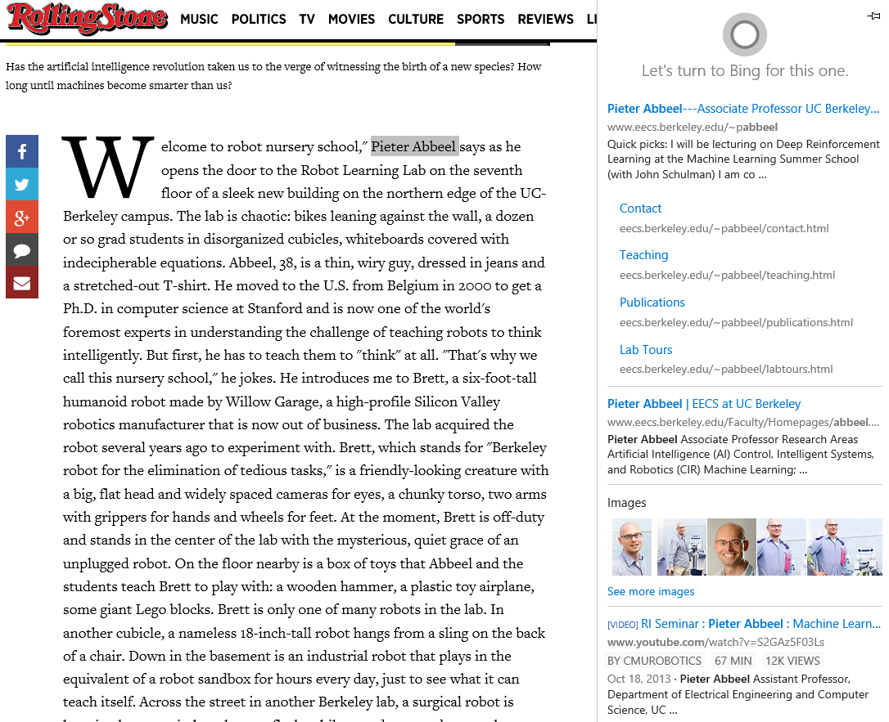
Entity Linking Service
Identify Entities - Identify mentions of people, places, and things within a document
Disambiguate Entities - Disambiguate mentions within the context of the sentence

Slide 44

Knowledge exploration Enable interactive search experiences over structured data via natural language inputs
Attribute histograms To enable rich visualization and interactive faceted experience
Structured query evaluation To efficiently retrieve detailed information about matching objects
Query auto-completion
To reduce user effort and help with discovery of rich capabilities
Natural language understanding
To interpret natural language queries into structured query expressions
Notes:
Do you have structured data for users to explore via natural language? The Knowledge Exploration Service takes structured data and linguistic resources you provide and creates a service that enables interactive search.
For example, as your users enter queries in a search box, the Knowledge Exploration Service offers auto-complete suggestions and semantic annotations. You can retrieve the top matching objects from the data, and you can create histograms of attribute values among the matches.

Slide 45
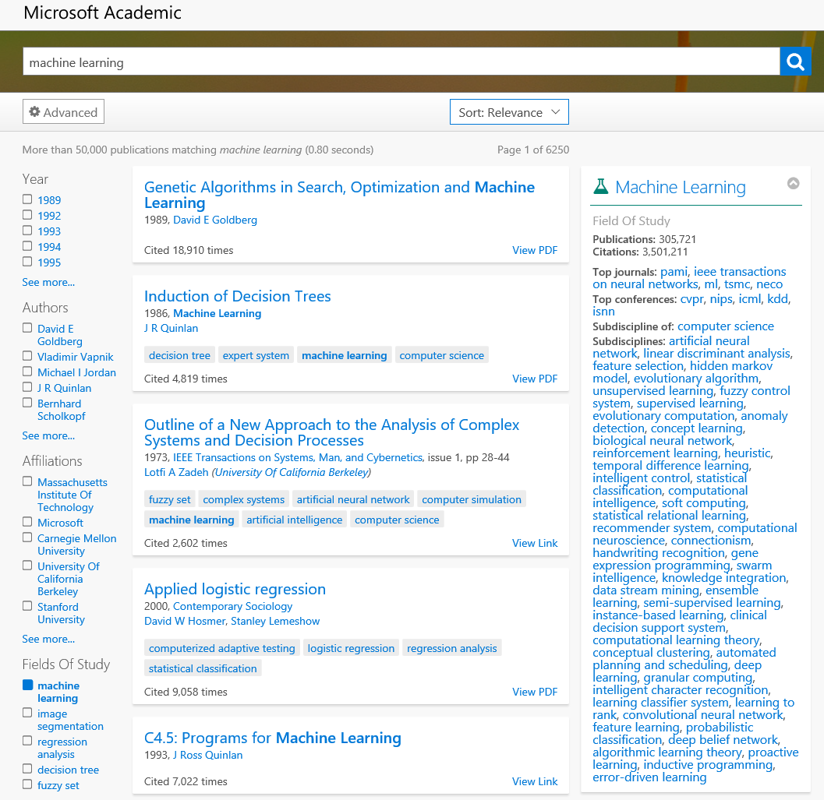
Knowledge Exploration Service
Explore your data – Enable interactive search over your own structured data.
Search in Natural Language - Search and browse your data using natural language
Get Query Auto-suggestions – Get suggestions as you type to get to the results faster

Slide 46


Recommendations
Increase catalog discovery Help customers easily discover items that they may be interested in
Personalize your experience Show suggestions that are targeted to each specific user
Increase the bottom line Increase your conversion rate by offering the right products at the right time
Notes:
The Recommendations API helps your customer discover items in your catalog.
Customer activity in your digital store is used to recommend items and to improve conversion in your digital store.
The recommendation engine may be trained by uploading data about past customer activity or by collecting data directly from your digital store. When the customer returns to your store you will be able to feature recommended items from your catalog that may increase your conversion rate.

Slide 47
Search
Access billions of web pages, images, videos, and news with the power of Bing APIs
Bing Web Search | Bing Image Search
Bing News Search | Bing Video Search
Bing Auto Suggest

Slide 48
Search
Web Search API
Image Search API
Video Search API
News Search API
Autosuggest API
Bring intelligent web search to your apps and harness the ability to comb billions of webpages, images, videos, news and autosuggest results with a few lines of code

Slide 49

Bing web search
Intelligent search to your apps with the ability to comb billions of webpages, images, videos, and news with a single API call Retrieve web documents indexed by Bing and narrow the results down with filters such as by answer type and freshness
Notes:
The Bing Search API adds intelligent search to your app, combing hundreds of billions of webpages, images, videos, and news to provide relevant results with no ad requirements. The results can be automatically customized to your users' locations or markets, increasing relevancy by staying local.

Slide 50
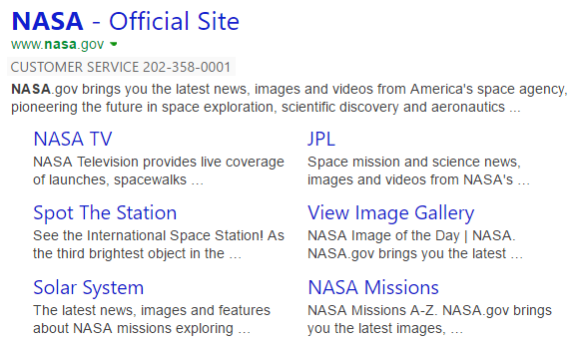

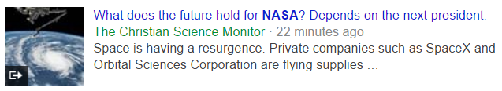

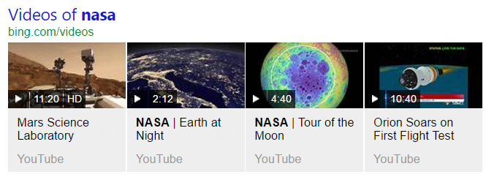
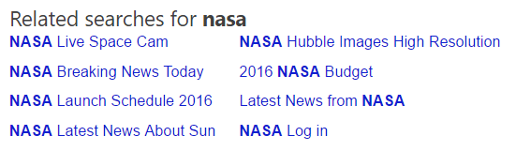
Web Search API
Get relevant web results and Answers with one API Call
https://bingapis.azure-api.net/v5/search?q=nasa
Web
Results
Search Response
Deep Links
(1st Algo)
{
“_type”: “SearchResponse”,
“queryContent”: {…},
“webPages”: {…},
“entities”: {…},
“news”: {…},
“images”: {…},
“places”: {…},
“videos”: {…},
“relatedSearches”: {…},
“rankingResponse”: {…}
}
Ranking Response
News Results
{
“answerType”:”WebPages”,
“resultIndex”:0,…
},
{
“answerType”:”News”,
“resultIndex”:1,…
}
Image
Results
Video Results
Related Searches
Notes:
Call-outs:
GET Request to REST Endpoint -> notice the URL schema (version / search vertical) and Request header to pass the subscription key
Foundation of the Search APIs : One call to rule them all -> Web + DeepLinks, Image, Video, News, Related Search Results
Ranking hint for optimal positioning in the page layout

Slide 51

Bing image search
A variety of image search options, from trending images to detailed insights Scour the web for images and get results that include thumbnail and full image URLs, publishing website, image metadata, related images, and more
Notes:
The Bing Image Search API gives you powerful image searching tools with a single call. You can tap into trending images of people, places, and things from around the world, and filter results by image style, size, layout, date added, and license type.

Slide 52
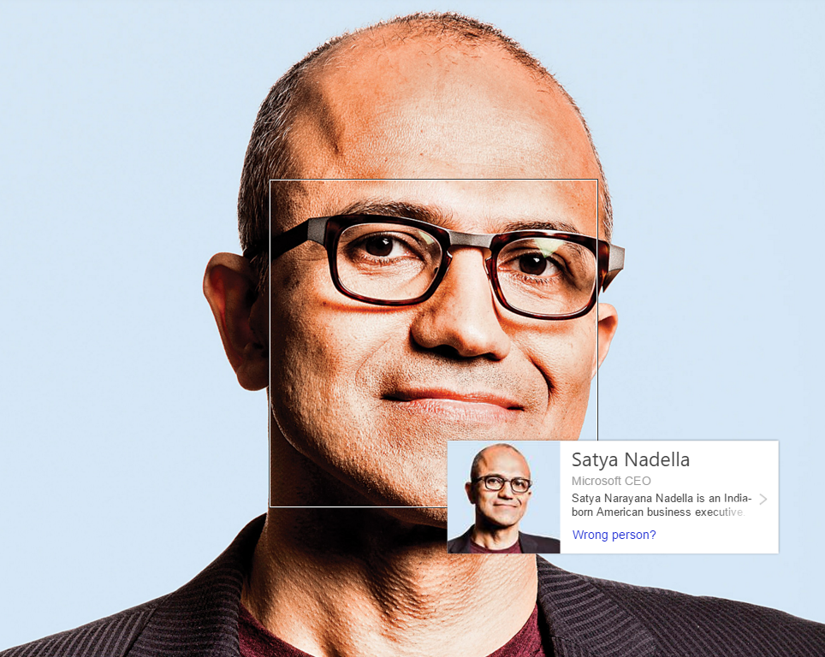





Image Insights
Access Bing’s deep image intelligence capabilities with a few lines of code
https://bingapis.azure-api.net/v5/images/search?q=<query>&insightstoken=<imageTokenId>&modulesRequested=<moduleType>
Entity Recognition
Visually Similar
Merchant/Recipe Sources
“matchingEntities” : [{
“entity” : {
“_type” : Person”,
“name” : “Satya Nadella”,
“visuallySimilarProducts” : [{
“name” : “…”,
“thumbnailUrl” : “…”,
“hostPageUrl” : “…”,
“shoppingSources” : [{
“offers” : [{
“url: : “http://www.contoso.com/…”
“seller” : “contoso.com”,

Slide 53

Bing video search
A variety of advanced video search features, including trending videos, price, and other useful metadata Find videos from across the web and get responses that provide useful metadata including creator, encoding format, video size and quality, and source view count
Notes:
The Bing Video Search API offers robust video searching features with a single API call. You can receive information from around the world about trending videos, updated on a daily basis. Search results can be returned by either a static image or a motion thumbnail, allowing you to customize how your users see what they're looking for.

Slide 54

Bing news search
Turn any app into a news desk with world news grouped and filtered by topic, local news, and metadata you can mine
Notes:
The Bing News Search API can help turn your app into an up-to-date news center. Results from a single call bring trending news from around the world, which is updated in near-real time, so users can be kept up to date on whatever's happening in their neighborhood—or across the globe.

Slide 55
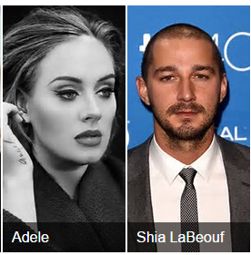
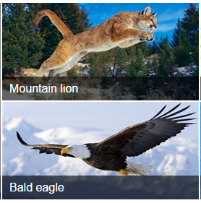




Trending on the Web
Explore what’s trending on the web as fast as it appears in Bing
Trending Images
Trending Videos
GET https://bingapis.azure-api.net
/v5/videos/trending
GET https://bingapis.azure-api.net
/v5/images/trending
Trending News
GET https://bingapis.azure-api.net/v5/news/search

Slide 56

Bing auto suggest
[
Query completion suggestions capabilities, so users can type less and get to what they want faster
Notes:
Whether you're searching the web, a local set of data, or just asking users to enter an input into your app, the Bing Autosuggest API helps narrow the search quickly by allowing your users to see suggestions for popular search terms. It can correct perceived mistakes, and returns detailed contextual suggestions according to other searches people have found useful.

Slide 57
Questions?

